Slide 1
Computer Networks
[Switching Techniques - DLL]

Slide 2
What is Switching?
Switching is the process of transferring data packets from one device to another in a network, or from one network to another, using specific devices called switches.
A computer user experiences switching all the time
For example, accessing the Internet from your computer device, whenever a user requests a webpage to open, the request is processed through switching of data packets only.
Switching takes place at the Data Link layer of the OSI Model. This means that after the generation of data packets in the Physical Layer, switching is the immediate next process in data communication.

Slide 3
Introduction to Switch
A switch is a hardware device in a network that connects and helps multiple devices share a network without their data interfering with each other.
A switch works like a traffic cop at a busy intersection. When a data packet arrives, the switch decides where it needs to go and sends it through the right port.
Some data packets come from devices directly connected to the switch, like computers or VoIP phones. Other packets come from devices connected through hubs or routers.
The switch knows which devices are connected to it and can send data directly between them. If the data needs to go to another network, the switch sends it to a router, which forwards it to the correct destination.

Slide 4
How Network Switch Works?
A switch is a dedicated piece of computer hardware that facilitates the process of switching i.e., incoming data packets and transferring them to their destination.
A switch primarily handles the incoming data packets from a source computer or network and decides the appropriate port through which the data packets will reach their target computer or network.
A switch decides the port through which a data packet shall pass with the help of its destination MAC (Media Access Control) Address.
A switch does this effectively by maintaining a switching table, (also known as
forwarding table).
A network switch is more efficient than a network Hub or repeater because it maintains a switching table, which simplifies its task and reduces congestion on a network, which effectively improves the performance of the network.

Slide 5
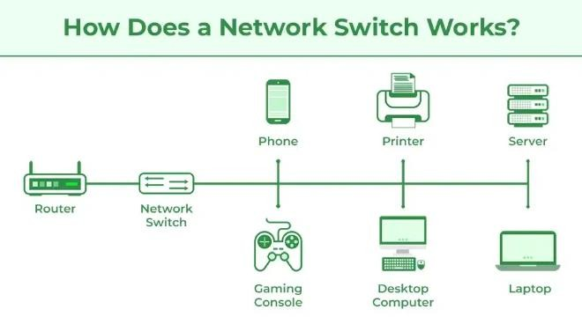
How Network Switch Works?

Slide 6
The Switching Process Involves:
Frame Reception:
The switch receives a data frame or packet from a computer connected to its ports.
MAC Address Extraction:
The switch reads the header of the data frame and collects the destination MAC Address from it.
MAC Address Table Lookup:
Once the switch has retrieved the MAC Address, it performs a lookup in its Switching table to find a port that leads to the MAC Address of the data frame.

Slide 7
The Switching Process Involves
Forwarding Decision and Switching Table Update:
If the switch matches the destination MAC Address of the frame to the MAC
address in its switching table, it forwards the data frame to the respective port.
However, if the destination MAC Address does not exist in its forwarding table, it follows the flooding process, in which it sends the data frame to all its ports except the one it came from and records all the MAC Addresses to which the frame was delivered.
This way, the switch finds the new MAC Address and updates its forwarding
table.
Frame Transition:
Once the destination port is found, the switch sends the data frame to that port
and forwards it to its target computer/network.

Slide 8
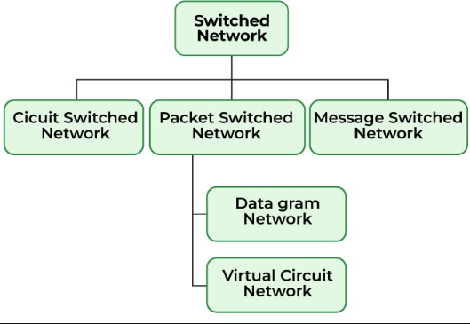
Types of Switching
There are three types of switching methods:
Message Switching
Circuit Switching
Packet Switching
Datagram Packet Switching
Virtual Circuit Packet Switching

Slide 9
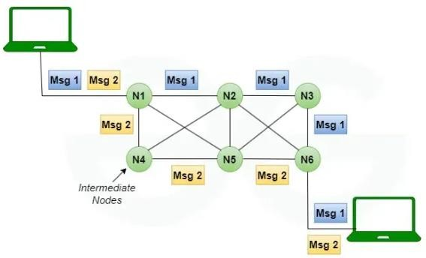
Message Switching
This is an older switching technique that has become obsolete.
In message switching technique, the entire data block/message is forwarded across the entire network thus, making it highly inefficient.

Slide 10
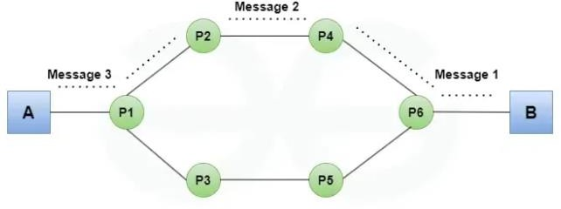
Circuit Switching
In this type of switching, a connection is established between the source and destination beforehand.
This connection receives the complete bandwidth of the network until the data is transferred completely.
This approach is better than message switching as it does not involve sending data to the entire network, instead of its destination only.

Slide 11
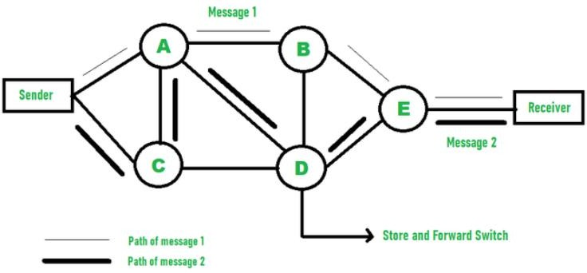
Packet Switching
This technique requires the data to be broken down into smaller components, data frames, or packets.
These data frames are then transferred to their destinations according to the available resources in the network at a particular time.
This switching type is used in modern
computers and even the Internet.
Here, each data frame contains additional information about the destination and other information required for proper transfer through network components.

Slide 12
Datagram Packet Switching
In Datagram Packet switching, each data frame is taken as an individual entity and thus, they are processed separately.
Here, no connection is established before data transmission occurs.
Although this approach provides flexibility in data transfer, it may cause a loss of data frames or late delivery of the data frames.

Slide 13
Virtual-Circuit Packet Switching
In Virtual-Circuit Packet switching, a logical connection between the source and destination is made before transmitting any data. These logical connections are called virtual circuits.
Each data frame follows these logical paths and provides a reliable way of transmitting data with less chance of data loss.

